Slide 1
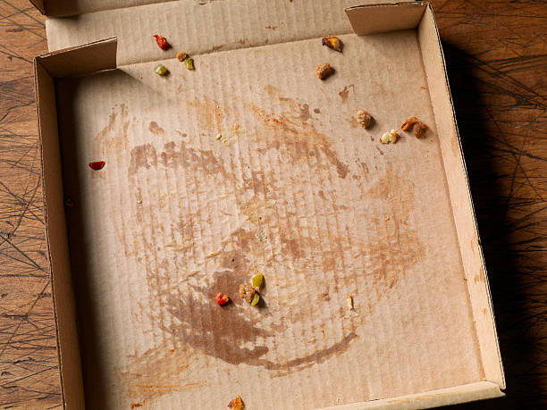
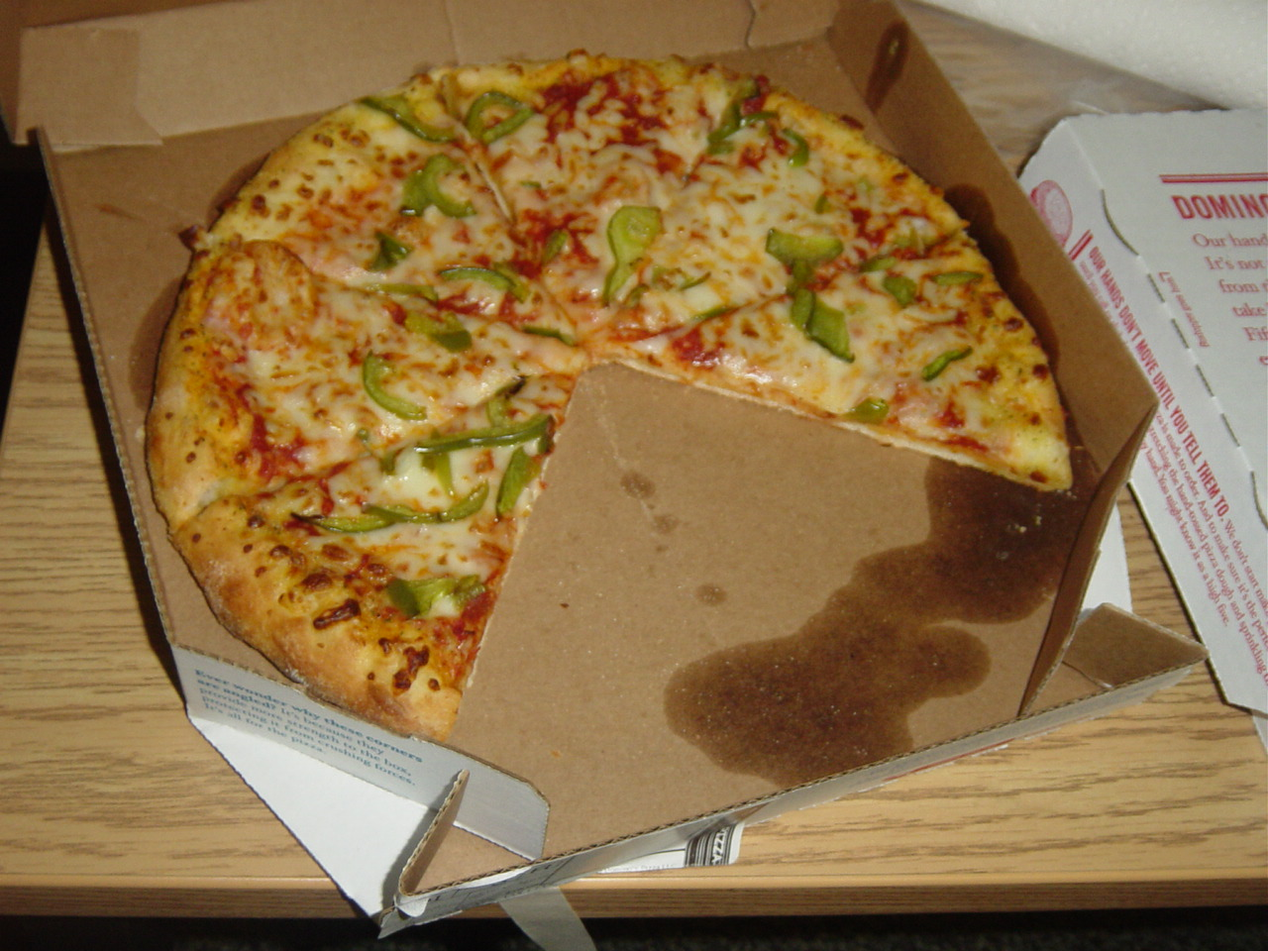
They have eaten the pizza.
They have been eating the pizza.
Which is completed (but is relevant now)?
Which is continuing?

Slide 2

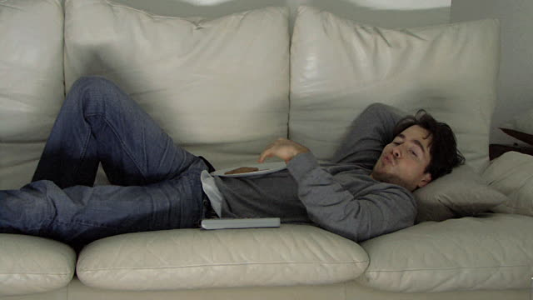
I have been running around the park so I’m tired.
I have run around the park so I’m tired.
Which finished most recently?
Which has an effect on the present?

Slide 3
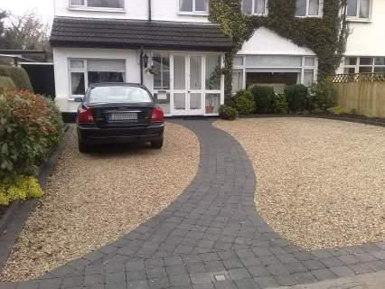
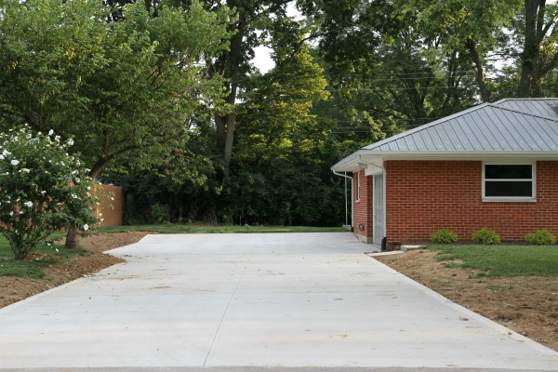
She has borrowed the car.
She has been borrowing the car for a while.
Which is repeated?
Which happened once?

Slide 4
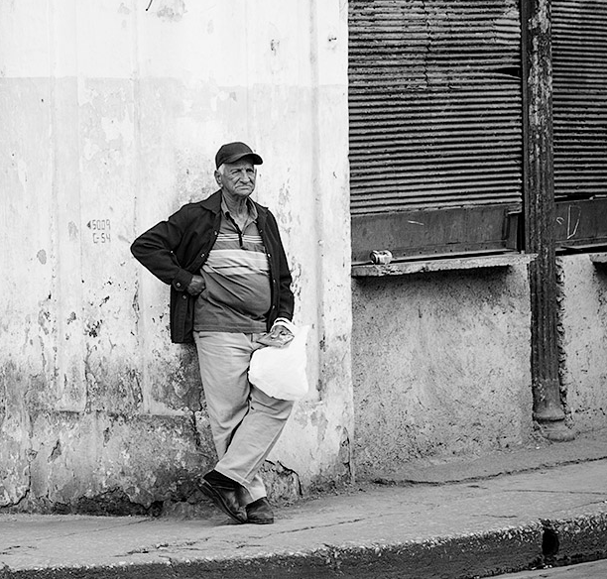
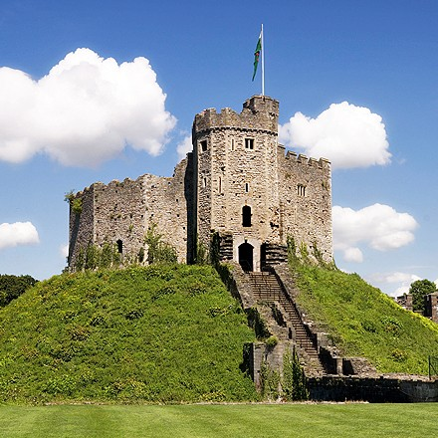
He has been standing on the corner all day.
The castle has stood on the hill for over 2000 years.
Which is temporary?
Which is permanent?

Slide 5


I’ve been travelling for 2 years.
I’ve travelled to over 30 countries.
Which is answers the question, How long?
Which answers the questions, How much/many?

Slide 6

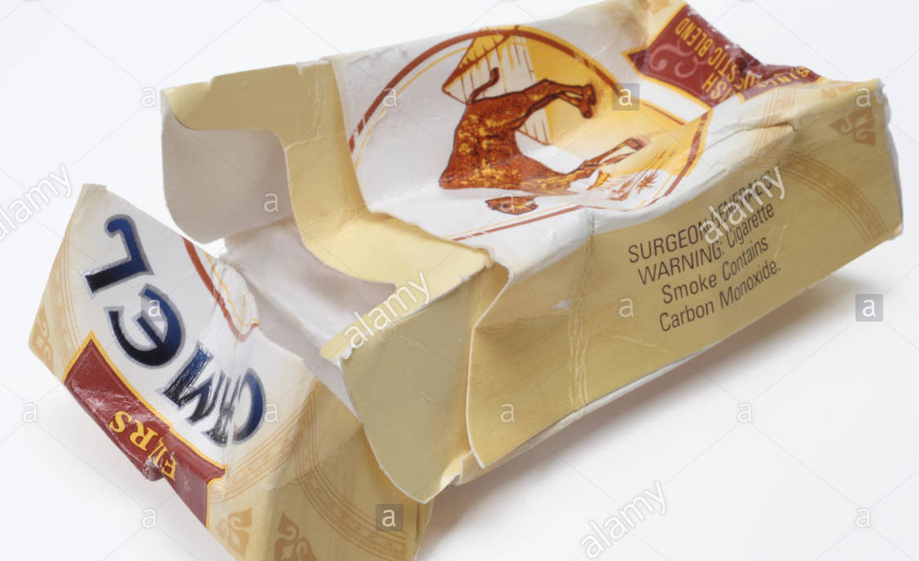
You’ve been smoking too much recently.
You’ve smoked all my cigarettes.
Which sentence is the action important?
Which sentence is the result important?

Slide 7
Recap
We use simple / continuous to talk about actions that were completed in the past but are relevant now.
We use simple / continuous to talk about actions that started in the past and are continuing now.
We use simple / continuous to talk about actions that have JUST stopped and are relevant now.
We use simple / continuous to talk about actions that are repeated.
We use simple / continuous to talk about actions that are permanent.
We use simple / continuous to answer the question How long? and How often?
We use simple / continuous when the result and NOT the action is important.

Slide 8
Complete the sentences with the present perfect simple or continuous
The car is working again now. The mechanic _________________________ (fix) it.
He ________________________ (live) in Cardiff for over 50 years. I don’t think he will ever move.
I __________________________ (clean) the house so my hands are still dirty.
You ________________________ (watch) TV for over 3 hours! Turn it off!
Barack Obama ________________________ (write) many books for children.
I am on a diet so I _________________________ (eat) more vegetables for every meal.
I _________________________ (not go) to Brazil before.
_________ you _________________ your car long?

Slide 9
Examples of Present Perfect Continuous in Films

